Slide 1

EMBEDDED SYSTEMS • EDGE AI • BIOMETRICS
Edge-AI Smart Access Control
Real-Time Face Recognition on STM32H7 via TFLite Micro & FreeRTOS
480 MHz
380 KB
On-Device
Cortex-M7
INT8 MobileNetV1
Zero Cloud
Metin Irkıçatal • Anıl Arda
Bare-metal firmware · TFLite Micro · FreeRTOS · Metric learning

Slide 2



PROBLEM STATEMENT
The Vulnerability of Cloud Biometrics
Three structural weaknesses make cloud-routed biometrics unfit for mission-critical access control.
Network Latency
Dependency Failures
Data Privacy Risks
Cloud round-trips introduce unpredictable delays — unacceptable for real-time access decisions at the door.
A network outage takes the entire system offline — intolerable for hospitals, labs and industrial facilities.
Shipping biometric templates off-device exposes them to interception and breaks KVKK / GDPR compliance.
Edge-AI Smart Access Control • STM32H7
2 / 16

Slide 3

OUR APPROACH
The Secure Edge Solution
Deterministic Execution
Inference runs in hardware with bounded, predictable latency.
Privacy by Design
All biometric data is confined to local memory — never leaves the chip.
100% On-Device
Cost & Energy Efficient
All capture, inference and decision logic run inside the STM32H743ZI — no external network call at any stage.
Orders of magnitude leaner than PC or GPU-class solutions.
Ultimate Reliability
Functional during full network blackouts — no dependency on the cloud.
Edge-AI Smart Access Control • STM32H7
3 / 16

Slide 4
SPECIFICATION
Defining the System Requirements
Functional Requirements
Non-Functional Requirements
1
Accept 96×96 grayscale frame injection
1
End-to-end latency < 500 ms per frame
2
Run the TFLite Micro inference pipeline locally
2
Total Flash ≤ 2 MB / Total SRAM ≤ 1 MB
3
Emit Accept / Reject decision via GPIO & UART
3
INT8 quantized model < 300 KB
4
Maintain deadlock-free FreeRTOS scheduling
4
FAR < 5% & FRR < 10%
Edge-AI Smart Access Control • STM32H7
4 / 16

Slide 5


TRAINING DATA
Expanding the Dataset via Augmentation
The Challenge. The AT&T Face Database carries limited variation per subject, creating a high risk of model overfitting.
Rotation Matrix
Bounding-Box Crop
Contrast Shift
Synthetic rotation produces angle-tolerant variants.
Systematic crops widen the framing distribution.
Lighting changes simulate real-world illumination.
Impact. Synthetic diversity lets the model generalize across head poses without millions of raw photos — keeping training cheap and the dataset on-task.
Edge-AI Smart Access Control • STM32H7
5 / 16

Slide 6

MODEL DEVELOPMENT
Transfer Learning: Fine-Tuning the Final Layers
Trainable Head
Frozen Base Layers (Feature Extraction)
Re-trained on the augmented set
01
Leverage the Pre-trained Backbone
02
Train Only the Final Layers
MobileNetV1 weights from ImageNet stay frozen — we keep the heavy convolutional features and skip the expensive training they would normally require.
The new head learns face-specific representations on our augmented set, adapting the network with a fraction of the compute and data.
Edge-AI Smart Access Control • STM32H7
6 / 16

Slide 7



MODEL DEPLOYMENT
Quantization & Flashing the Updated Model
1
2
3
Optimize
Compile
Flash
INT8 post-training quantization shrinks the fine-tuned model below 300 KB while preserving accuracy.
The quantized model is converted to a C byte-array, ready to embed directly into firmware.
Model + pre-computed reference embeddings are written to the STM32H7 internal Flash — fully self-contained.
Result. The board is now completely standalone and intelligent — every byte of intelligence sits in on-chip Flash, no external dependency at runtime.
Edge-AI Smart Access Control • STM32H7
7 / 16

Slide 8
FIRMWARE ARCHITECTURE
The FreeRTOS Deterministic Pipeline
T1
T2
T3
T4
Frame Capture
→
Preprocessing
→
Inference
→
Access Control
Priority: Highest
Priority: High
Priority: Lowest
Priority: High
DMA interrupt grabs a 96×96 frame.
INT8 normalization + tensor pack.
TFLite Micro runs the network.
GPIO + UART emit the decision.
Deterministic Scheduling Constraints
T1 holds the highest priority — DMA interrupts are serviced immediately.
T3 (neural net) holds the lowest priority — heavy compute can never starve time-critical capture.
Tasks are linked sequentially through semaphores and queues — deadlock-free by construction.
Edge-AI Smart Access Control • STM32H7
8 / 16

Slide 9
INFERENCE STRATEGY
Metric Learning: Cross-Similarity Inference
We don't classify — we compare.
Cosine Similarity
The TFLite Micro network acts as a feature extractor. Its penultimate layer outputs a unique numerical embedding for every face it sees.
Reference vector
Live vector
We measure the cosine similarity between the live embedding and reference embeddings stored in Flash. A high similarity = a biometric match.
θ
New users are enrolled by storing a fresh reference vector — no model retraining required.
small θ → high cos(θ) → match
Edge-AI Smart Access Control • STM32H7
9 / 16

Slide 10

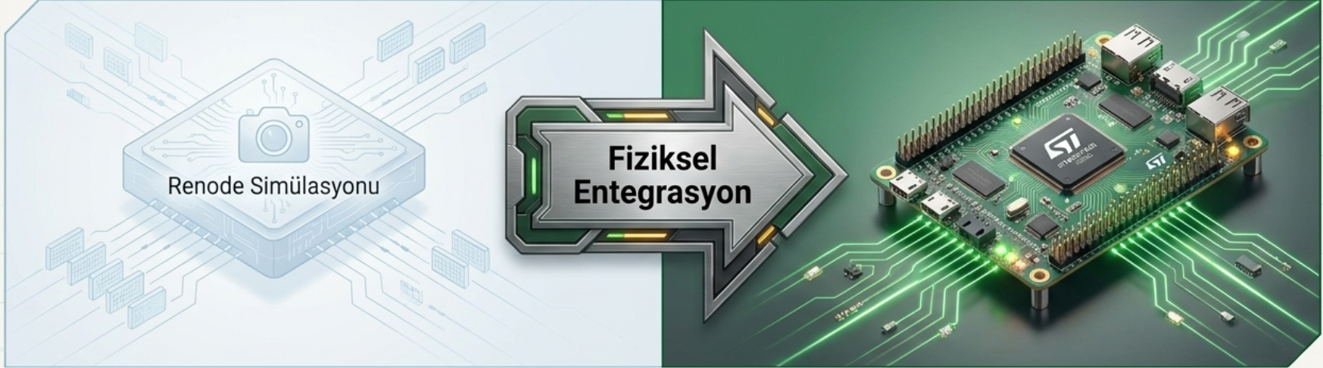
HARDWARE BRING-UP
From Theory to Practice: Hardware Transition
YESTERDAY / VIRTUAL
TODAY / PHYSICAL
Renode Simulation
STM32H743ZI Board
The same firmware now runs on real silicon — bare-metal, no HAL, direct register access. The transition validates that our software works in both simulated and physical environments.
Memory-mapped virtual environment exposed UART and ST-LINK without real electrical interfaces — letting us build and prove the firmware stack purely in software.
Edge-AI Smart Access Control • STM32H7
10 / 16

Slide 11


COMMUNICATION LAYER
UART & Frame Protocol Design
Sync Pattern
Length
Payload
CRC-16
0xAA 0x55 0xAA 0x55
9216
96 × 96 grayscale
CCITT-FALSE
4 B
2 B
9216 B
2 B
Total frame → ~9224 B • bare-metal uart.c & frame_proto.c drivers
Error Recovery
Integrity
A 4-byte sync-pattern hunt re-locks the receiver after any framing slip — no permanent loss of sync on the wire.
CRC-16/CCITT-FALSE validates every payload — only loss-free frames reach the TFLite Micro engine.
Edge-AI Smart Access Control • STM32H7
11 / 16

Slide 12
WHAT CHANGED
Architectural Comparison: Virtual vs. Real Hardware
System Component
Renode (Virtual)
STM32H7 (Real Hardware)
Camera I/O
Memory-mapped virtual sensor
16 KB interrupt-based UART RX ring buffer
Output Logging
Virtual terminal log
Physical GPIO + PC-parseable [RESULT] frames
System Clock
Cycle-accurate virtual clock
64 MHz HSI clock (real silicon)
Interrupt Control
Simplified virtual NVIC
Full 166-entry vector table via startup.s
Edge-AI Smart Access Control • STM32H7
12 / 16

Slide 13
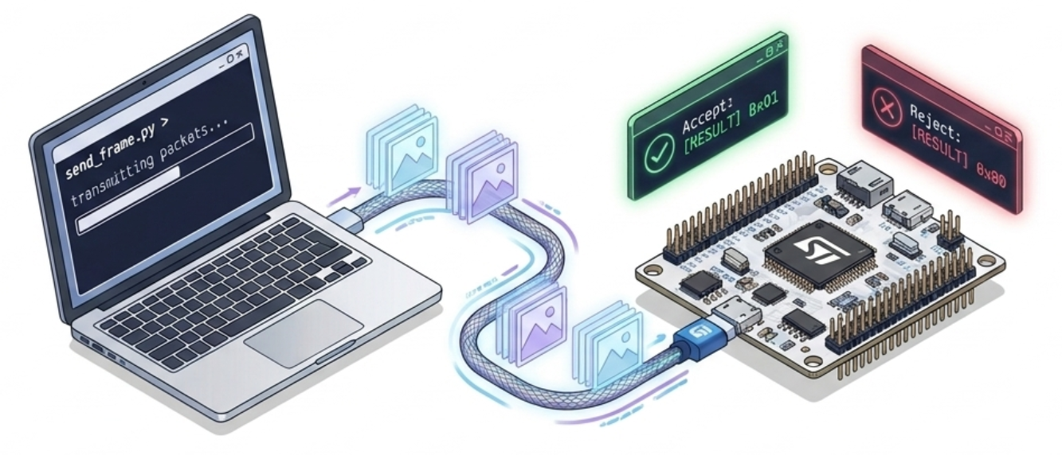





VALIDATION
Real-World Test Automation: Python Host
Python Host
STM32H7
AT&T dataset reader
Returns [RESULT] flags
UART @ 115200
Image Pipeline
Protocol Framing
Batch Testing
Reads PGM images on the fly and rescales them to the 96×96 format expected by the board.
Wraps each frame with the sync header, length, payload and CRC required by the firmware.
Streams frames from 40 subjects, parses the [RESULT] tags, computes FAR / FRR on real hardware.
Edge-AI Smart Access Control • STM32H7
13 / 16

Slide 14

MEASUREMENTS — 64 MHz SNAPSHOT
Hardware Performance & Resource Utilization
622 KB
395 KB
37 ms
Flash usage
SRAM usage
AI inference
30% of 2 MB
38% of 1 MB
@ 64 MHz
Holds the INT8 model and the entire FreeRTOS firmware. Well below capacity.
Includes the 16 KB UART RX buffer and the 2048-word inference stack. Plenty of headroom.
Already excellent at low clock. Expected to drop to ~5 ms at 480 MHz PLL.
Today's bottleneck. End-to-end time is dominated by the ~800 ms UART transfer at 115 200 baud — not compute. The next slide attacks exactly that.
Edge-AI Smart Access Control • STM32H7
14 / 16

Slide 15
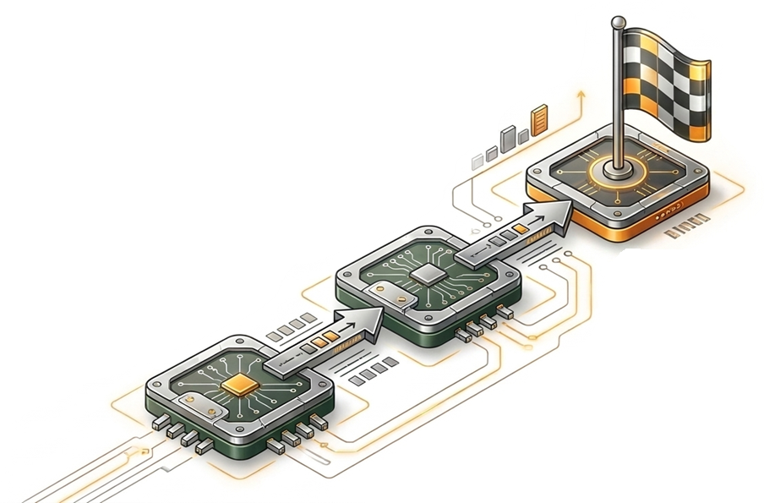

ROADMAP
Target. End-to-end latency below 500 ms with zero CPU overhead on UART reception.
Future Steps:
Maximum Performance Optimization
01
Clock Bring-up
Migrate from the 64 MHz HSI to the 480 MHz PLL via VOS0 voltage scaling. Inference target drops to ~5 ms, exposing the data-transfer wall as the next limiter.
02
DMA-based Comms
Replace interrupt-driven UART RX with DMA + idle-line detection. CPU is fully bypassed during transfer, eliminating per-byte overhead.
Edge-AI Smart Access Control • STM32H7

Slide 16
Thank you.
Questions are welcome.
TFLite Micro
FreeRTOS
STM32H7 — bare-metal
Metin Irkıçatal • Anıl Arda

